Slide 1
Database Pooling in .NET

Slide 2
What Will Be Shared?
Introduction to Database Pooling
How Database Pooling Works
Configuring Connection Pooling in .NET Core
Best Practices for Efficient Pooling
Monitoring & Troubleshooting Connection Pooling

Slide 3
Introduction to Database Pooling
What is Database Pooling?
Database pooling is a technique used to manage and reuse database connections efficiently
Benefits of Connection Pooling:
Reduces overhead of opening/closing connections repeatedly.
Improves performance by reduces connection creation time.
Efficient resource utilization by prevents unnecessary load on the database server.
Reduces the risk of exhausting database connection under high traffic.

Slide 4
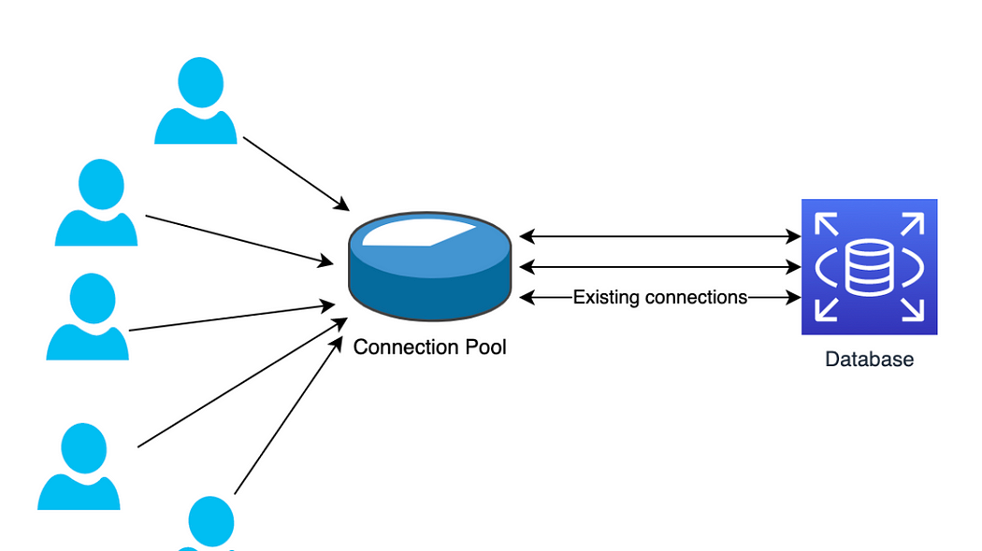
How Database Pooling Works
How it works :
When a connection is requested, an existing one from the pool is provided if available.
If no available connections exist and the pool limit isn’t reached, a new one is created.
Connections are returned to the pool when no longer needed.
Idle connections are closed after a timeout.
Pooling Lifecycle :
Creation -> Reuse -> Release -> Cleanup (if idle of expired)

Slide 5
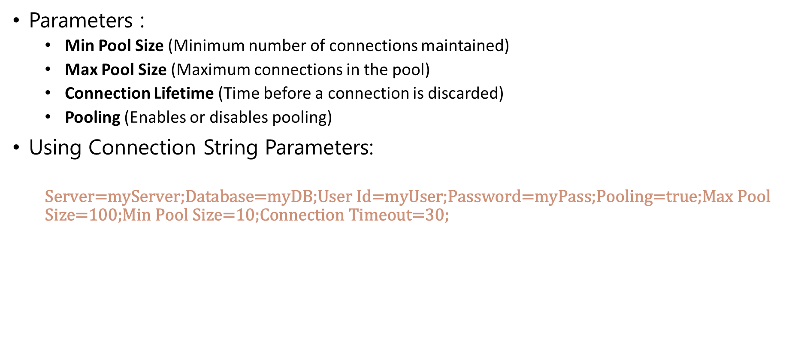
Configuring Connection Pooling in .NET Core
Parameters :
Min Pool Size (Minimum number of connections maintained)
Max Pool Size (Maximum connections in the pool)
Connection Lifetime (Time before a connection is discarded)
Pooling (Enables or disables pooling)
Using Connection String Parameters:
$$\text{Server}\text{=}\text{myServer}\text{;}\text{Database}\text{=}\text{myDB}\text{;}\text{User} \text{Id}\text{=}\text{myUser}\text{;}\text{Password}\text{=}\text{myPass}\text{;}\text{Pooling}\text{=}\text{true}\text{;}\text{Max} \text{Pool} \text{Size}\text{=100;}\text{Min} \text{Pool} \text{Size}\text{=10}\text{;}\text{Connection} \text{Timeout}\text{=30}\text{;}$$

Slide 6
Best Practices for Efficient Pooling
Use Dependency Injection for DbContext
services.AddDbContextPool<ApplicationDbContext>(options => options.UseSqlServer(connectionString));
Dispose DbContext and SqlConnection properly
Implement proper exception handling

Slide 7
Monitoring & Troubleshooting Connection Pooling
Tools for Monitoring:
SQL Server Profiler
SQL Server DMVs
Sys.dm_exec_connections -> Shows active connections.
Sys.dm_exec_requests -> Displays executing requests.
Logging connection usage in application

Slide 8
Q & A

Slide 9
Reference
https://learn.microsoft.com/en-us/dotnet/framework/data/adonet/sql-server-connection-pooling
https://www.csharp.com/uploadfile/mahesh/understanding-connection-pooling-in-ado-net/
https://medium.com/@serhatalftkn/dbcontext-pooling-in-net-8-a-deep-dive-into-performance-optimization-9e7af6f480f0

